Slide 1
Natural Language Processing Specialization Reformer with LSH Attention
(2021 Deeplearning.ai)
YangXi’s Reading Notes

Slide 2
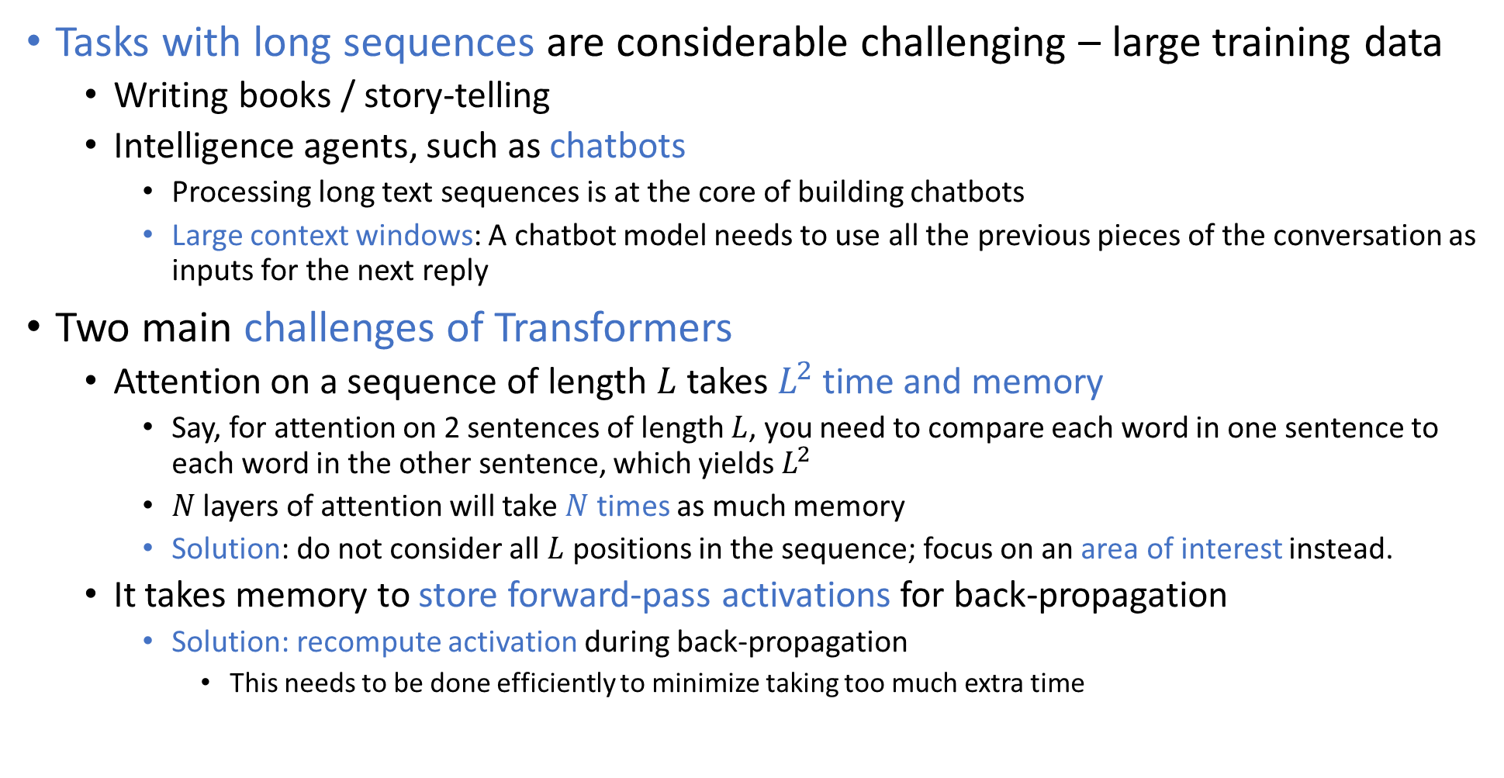
Transformer Complexity
Tasks with long sequences are considerable challenging – large training data
Writing books / story-telling
Intelligence agents, such as chatbots
Processing long text sequences is at the core of building chatbots
Large context windows: A chatbot model needs to use all the previous pieces of the conversation as inputs for the next reply
Two main challenges of Transformers
Attention on a sequence of length $L$ takes $L^{2}$ time and memory
Say, for attention on 2 sentences of length $L$, you need to compare each word in one sentence to each word in the other sentence, which yields $L^{2}$
$N$ layers of attention will take $N$ times as much memory
Solution: do not consider all $L$ positions in the sequence; focus on an area of interest instead.
It takes memory to store forward-pass activations for back-propagation
Solution: recompute activation during back-propagation
This needs to be done efficiently to minimize taking too much extra time

Slide 3
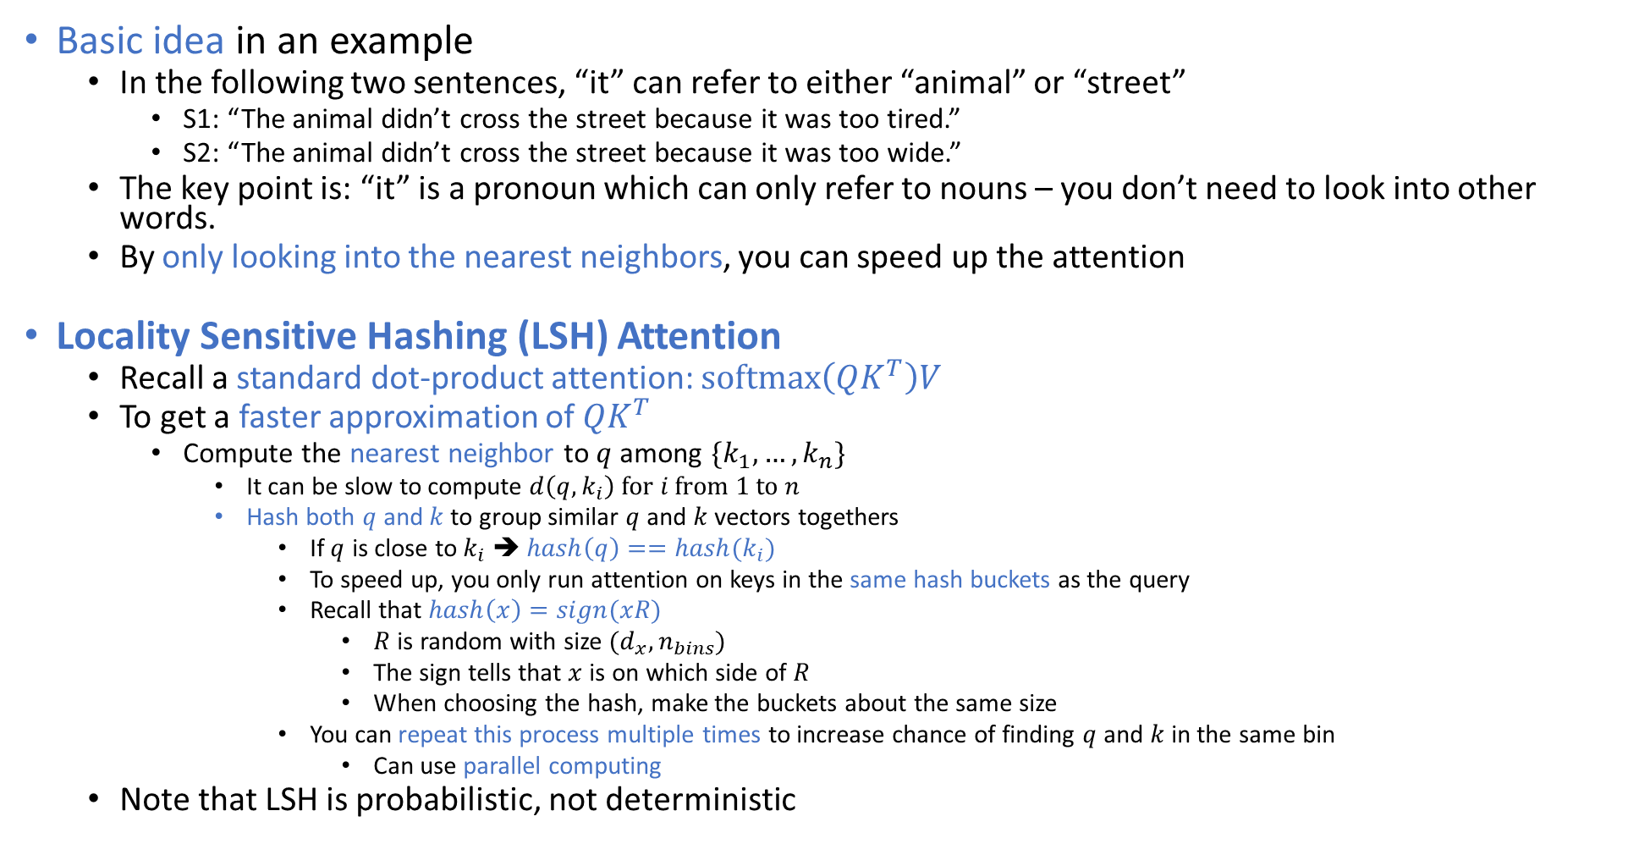
Locality Sensitive Hashing (LSH) Attention
Basic idea in an example
In the following two sentences, “it” can refer to either “animal” or “street”
S1: “The animal didn’t cross the street because it was too tired.”
S2: “The animal didn’t cross the street because it was too wide.”
The key point is: “it” is a pronoun which can only refer to nouns – you don’t need to look into other words.
By only looking into the nearest neighbors, you can speed up the attention
Locality Sensitive Hashing (LSH) Attention
Recall a standard dot-product attention: $softmax\left(QK^{T}\right)V$
To get a faster approximation of $QK^{T}$
Compute the nearest neighbor to $q$ among $\{k_{1},…,k_{n}\}$
It can be slow to compute $d\left(q,k_{i}\right) for i from 1 to n$
Hash both $q$ and $k$ to group similar $q$ and $k$ vectors togethers
If $q$ is close to $k_{i}$ ➔ $hash\left(q\right)==hash(k_{i})$
To speed up, you only run attention on keys in the same hash buckets as the query
Recall that $hash\left(x\right)=sign(xR)$
$R$ is random with size $(d_{x}, n_{bins})$
The sign tells that $x$ is on which side of $R$
When choosing the hash, make the buckets about the same size
You can repeat this process multiple times to increase chance of finding $q$ and $k$ in the same bin
Can use parallel computing
Note that LSH is probabilistic, not deterministic

Slide 4
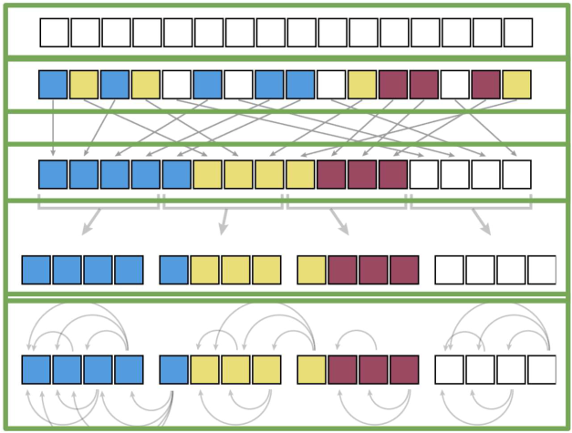
Locality Sensitive Hashing (LSH) Attention
QK attention: the model outputs a single vector at each position, which serves both as a query and a key
LSH bucketing: use LSH to map each vector to a bucket.
Sort the vectors by LSH bucket
For parallelize: first, split the sorted sequence into fixed size chunks, to allow efficient parallel computation on GPU/TPU, which works better on large blocks with uniform sizes.
Then, let each chunk attend within itself and the previous chunk, to cover the case where a hash bucket is split over more than one chunk

Slide 5
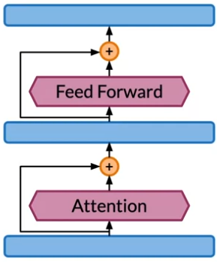
Memory Efficiency Challenge
During forward propagation, you usually store some intermediate data to be used to compute the back propagation.
For example, you have a book of 1 million tokens, each represented by a 512 vector
As a result, the input to the model is already 2GB
A transformer has two types of layers: attention layers and feed-forward layers
Suppose you only save the activations from the boundaries between each layer
That is 2 GB per layer
Say you have 12 of each type of layer. In total you need 12 * 2 * 2 + 2 = 50 GB memory
This cannot be fit on a single device!
The transformer network proceeds by repeatedly adds residuals to the hidden states
In back-propagation, you need to subtract the residuals in the opposite order, starting from the output.
In order to save memory, you need to be able to re-compute the residuals quickly, instead of storing them

Slide 6
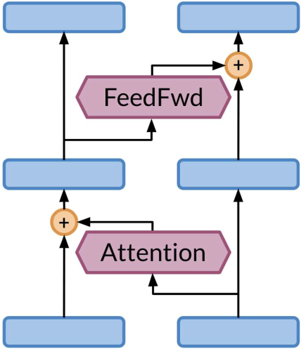
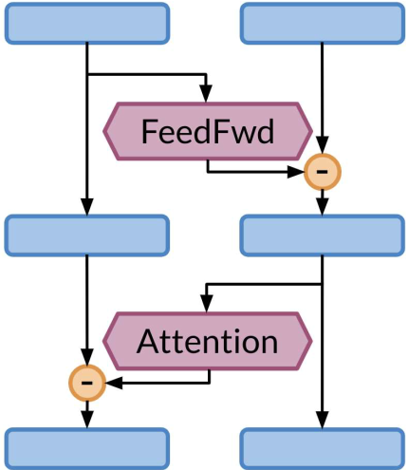
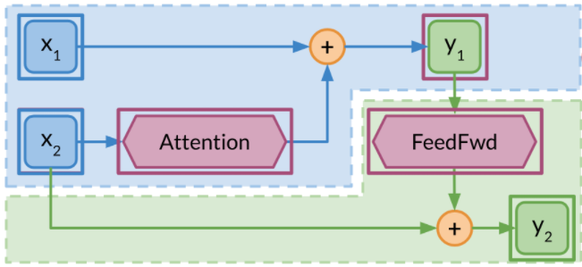
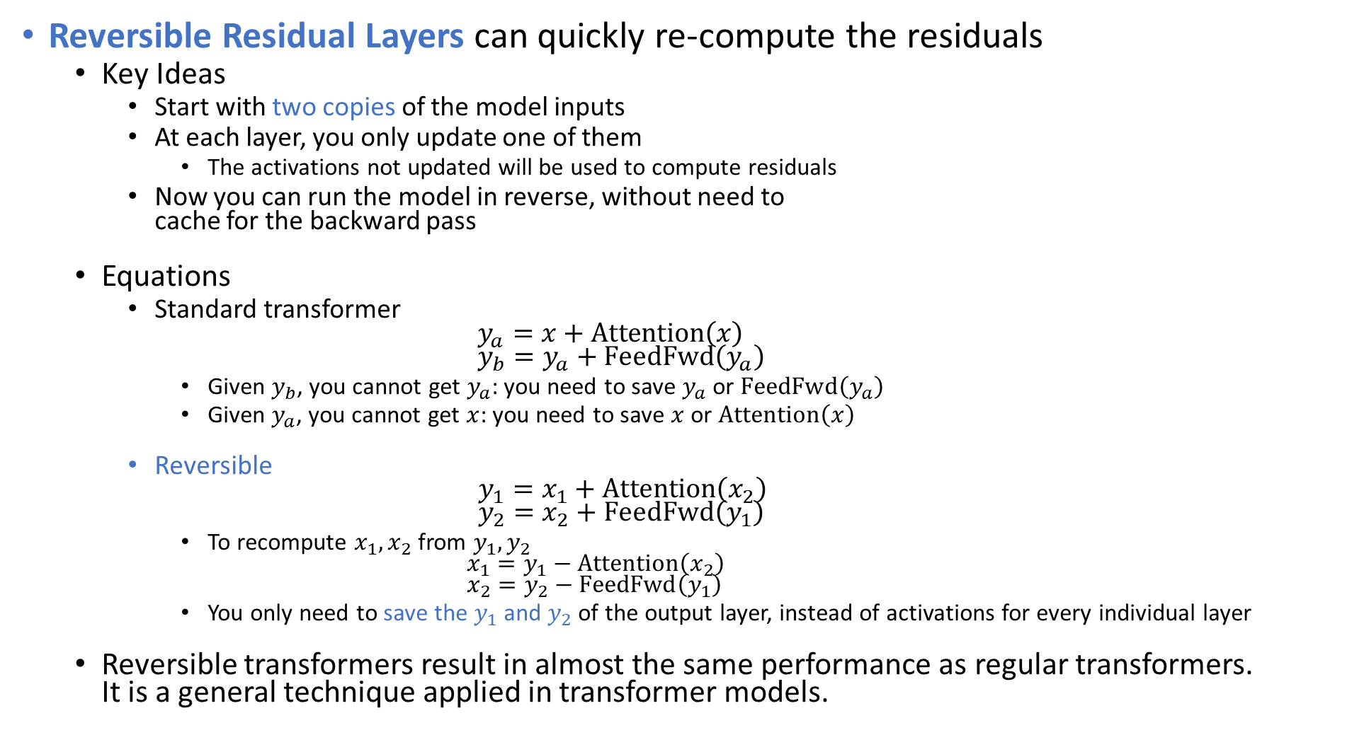
Reversible Layers
Reversible Residual Layers can quickly re-compute the residuals
Key Ideas
Start with two copies of the model inputs
At each layer, you only update one of them
The activations not updated will be used to compute residuals
Now you can run the model in reverse, without need to cache for the backward pass
Equations
Standard transformer $y_{a}=x+Attention\left(x\right)$ $y_{b}=y_{a}+FeedFwd\left(y_{a}\right)$
Given $y_{b}$, you cannot get $y_{a}$: you need to save $y_{a}$ or $FeedFwd\left(y_{a}\right)$
Given $y_{a}$, you cannot get $x$: you need to save $x$ or $Attention\left(x\right)$
Reversible $y_{1}=x_{1}+Attention\left(x_{2}\right)$ $y_{2}=x_{2}+FeedFwd\left(y_{1}\right)$
To recompute $x_{1}, x_{2}$ from $y_{1}, y_{2}$ $x_{1}=y_{1}−Attention\left(x_{2}\right)$ $x_{2}=y_{2}−FeedFwd\left(y_{1}\right)$
You only need to save the $y_{1}$ and $y_{2}$ of the output layer, instead of activations for every individual layer
Reversible transformers result in almost the same performance as regular transformers. It is a general technique applied in transformer models.

Slide 7
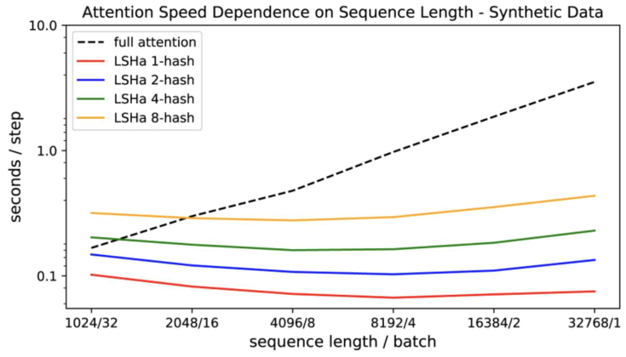
Reformer
Reformer – The Reversible Transformer
Fit up to 1 million tokens on a single 16 GB GPU
Handle context windows of up to 1 million words
Use LSH Attention to reduce the complexity of attending over long sequences
Take roughly the same time regardless of sequence length
Use Reversible Layers to use memory more efficiently

Slide 8
Chat-bot
MultiWoz dataset
More than 10,000 human annotated dialogues
Spans multiple domains and topics
Some dialogues include multiple domains; others include single domains

